Slide 1
Functions Part 2

Slide 2
Making Functions More Versatile
We can add multiple parameters to a function.
If we want a value to be changeable by user, but have a default value, we can set the parameter equal to the default value within the function definition.
If some parameters have default values, the user can choose to input some arguments but not others. So the number of arguments might be less than the number of parameters.
The number of arguments will always be less than or equal to the number of parameters, never greater than.

Slide 3
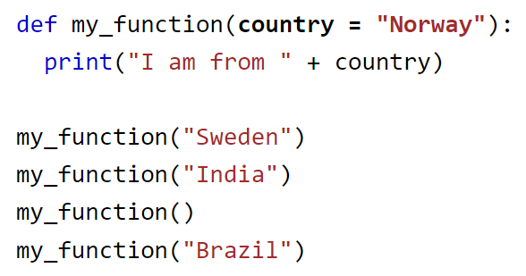
Default Values
What is the output of this code?
If the user calls the function with an argument, that overrides the default value, so the default is ignored.
If the user calls the function without an argument, the default is selected.
(Example from w3schools)

Slide 4
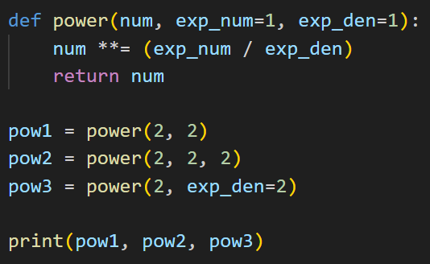
Default Values
What is the output of this code?
Positional argument passing
Keyword argument passing allows you to skip a parameter. The skipped parameter gets assigned the default value.
What are other ways you could call the function to get the same output?

Slide 5
Exercise
Write a function called center that returns either the mean or median of a list of numbers.
This function should take two parameters: A list of numbers, and an optional parameter called use_median which should default to False.
If use_median is False, return the mean of the list.
If use_median is True, return the median of the list.
Test your function by calling it with different arguments.

Slide 6
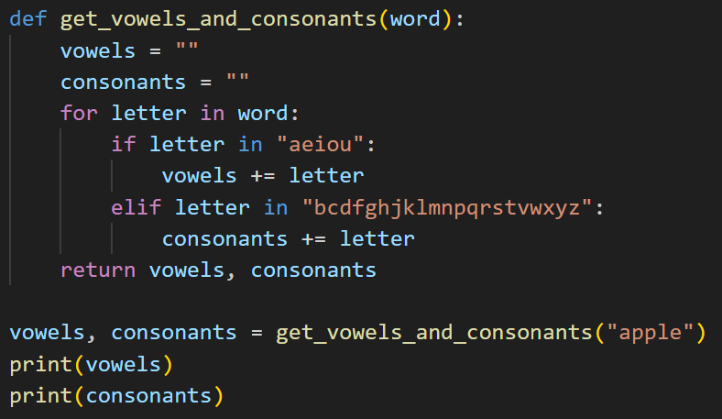
Returning Multiple Values
Sometimes it is useful to return multiple values from a function.
A convenient way to do this is by returning multiple values separated by commas, and you can set each return value to a variable when you call the function, similar to unpacking a tuple.
Make sure the number of return values lines up, otherwise you will get an error.
What is the output of this code?

Slide 7
Exercise
Write a Python function called get_stats that takes in a list of numbers and returns the following three values: The mean, the median, and the mode of the list.
Call the function on a list, and print each statistic on a separate line.
my_list = [1,2,4,5,5]
Output:
Mean: 3.4
Median: 4
Mode: 5

Slide 8
Global Variables
If you create a variable in a function, it’s only available while the function is running. Once the function ends, it goes out of scope.
If you create a variable outside a function, that variable is global, which means it’s always in scope.
If you want to create a global variable in a function, you must use the global keyword. You can also do this to modify existing global variables within a function.

Slide 9
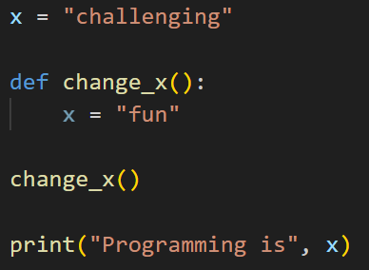
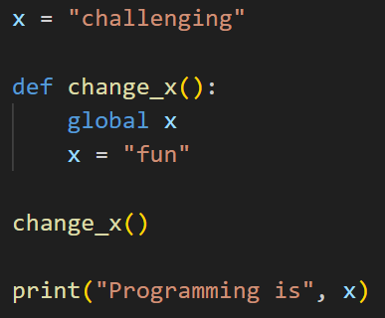
Exercise
What is the output of this code?
What about this code?
Is the output the same or different? Why?

Slide 10
Documenting a Function

Slide 11
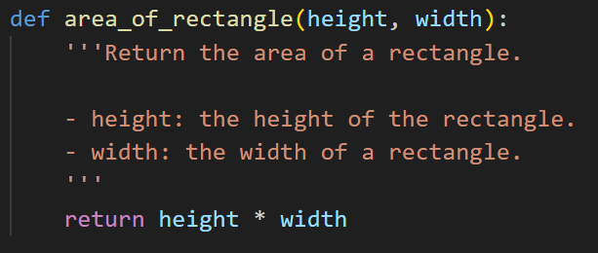
Docstring
On the first line of your function, after the header, you can write a comment called a doc string.
The docstring should contain:
A description of the function
Each parameter and its purpose
The return value of the function
Docstring PEP: https://peps.python.org/pep-0257/

Slide 12
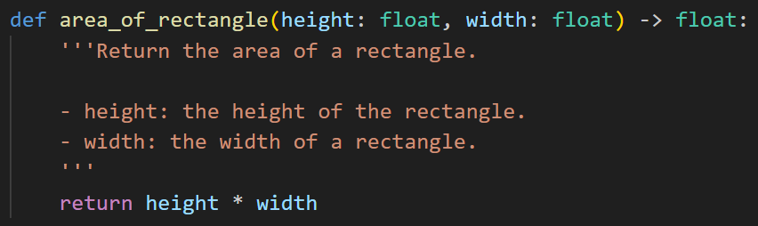
Type Hinting
Many programming languages are statically typed, so you must declare the type of each variable.
Python is dynamically typed, so it figures out the type of each variable automatically.
Sometimes when you’re writing functions, you want to specify the type of each variable. In Python, this is optional, and called type hinting.

Slide 13
Exercise
Go back to one function that you wrote earlier in this class and add some documentation to it.
Add type hinting and a docstring.

Slide 14
Lambdas: Anonymous Functions

Slide 15
Lambda
A lambda is a small anonymous function. It can take any number of arguments, but it can only have one expression, which is returned.
Syntax: lambda arguments : expression
A lambda is a way to define a function in one line.
Example:
add_2 = lambda a : a + 2
print(add_2(2))
What is the output when you run the above two lines of code?

Slide 16


Lambdas vs Functions
This lambda:
name = lambda arg : expr
Is equivalent to this function:
def name(arg):
return expr
For example, these two code snippets are equivalent:
1.
2.

Slide 17
Why use Lambdas?
You can put lambdas inside functions to make a more versatile function.
Exercise: What is the output of this code?
def multiplier(n):
return lambda num : num * n
doubler = multiplier(2)
tripler = multiplier(3)
print(doubler(5))
print(tripler(5))

Slide 18
Exercise
Write a lambda that computes the n-th power of a number, given two arguments, num and n.
Now, write a function that is equivalent to the lambda.

Slide 19
More on Lambdas
Lambdas are derived from Lambda calculus, and are a core part of functional programming languages such as Lisp, Scheme, and Haskell.
Python, along with most programming languages, is considered an imperative language. A few functional programming topics (such as lambdas) have been added to Python, and they are more bonus features instead of a core part of the language.
Some other topics include filter, map, and reduce.
Lambdas can be used alongside filter, map, and reduce, and also as a key with the sorted() function in Python.

Slide 20
Example: Lambda and Map
Here’s a more complex use of lambdas in Python.
The map() function in Python takes a function and applies it to every item in a list. You can use map() with a lambda:
L = list(map(lambda x: x.upper(), ['cat', 'dog', 'cow']))
print(L)
What do you think the output of this code is?
How does this compare to using list comprehensions?

Slide 21
Example: Sorting with Lambda
You can use a lambda as the key parameter to the sorted() function to customize how an iterable is sorted.
Let’s say we have a list of dictionaries that represent students. Each student has a name and a grade from 0 to 100.
Use the sorted function to sort the students by name:
students_by_name = sorted(students, key = lambda s: s['name'])
Now, use the sorted function to sort the students by grade:
students_by_grade = sorted(students, key = lambda s: s['grade'])

Slide 22
Resources
Global variables: https://www.w3schools.com/python/gloss_python_global_variables.asp
Docstring conventions: https://peps.python.org/pep-0257/
Type hinting in Python (for function documentation): https://docs.python.org/3/library/typing.html
Lambda basics: https://www.w3schools.com/python/python_lambda.asp
Longer article on lambdas: https://realpython.com/python-lambda/

